Slide 1
A quick introduction to...

Slide 2
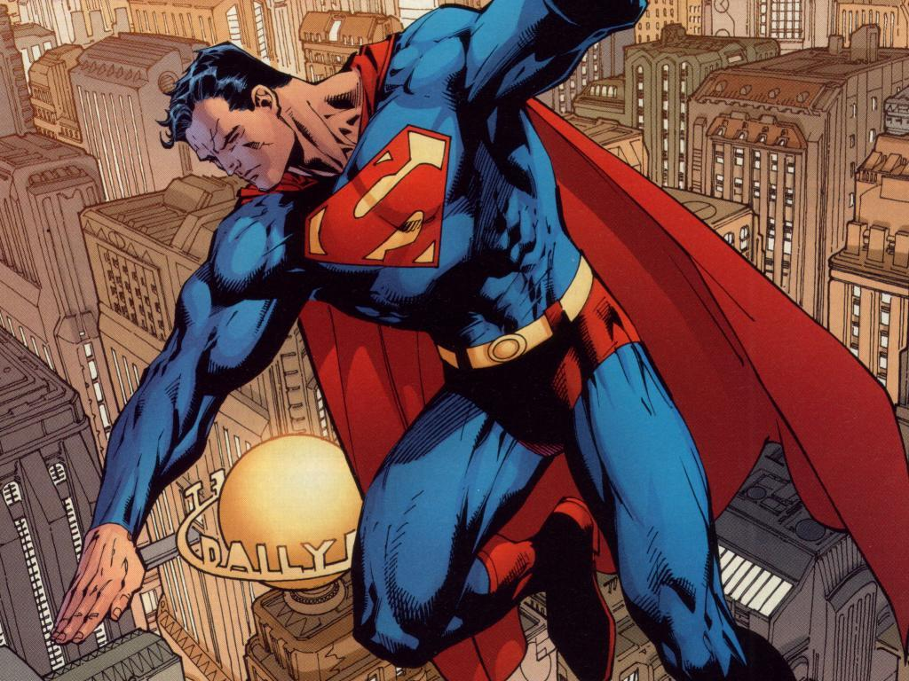
What is Comic Life?
Comic Life is a comic desktop publishing program designed to create comic strips or arrange photos into a scrapbook

Slide 3
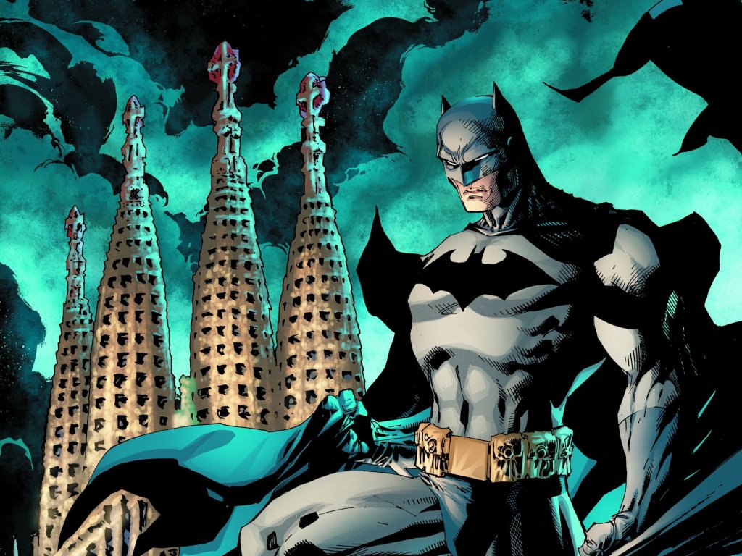
Why Comic Life?
Fun!
Easy to learn
Inspires Creativity
Reading
Engaging
Writing
Easy to remember

Slide 4
Thinking Skills and Personal Capabilities
Managing Information
Thinking, Problem-Solving
Decision making
Being Creative
Self Management
Working with others
Communication
Using ICT

Slide 5
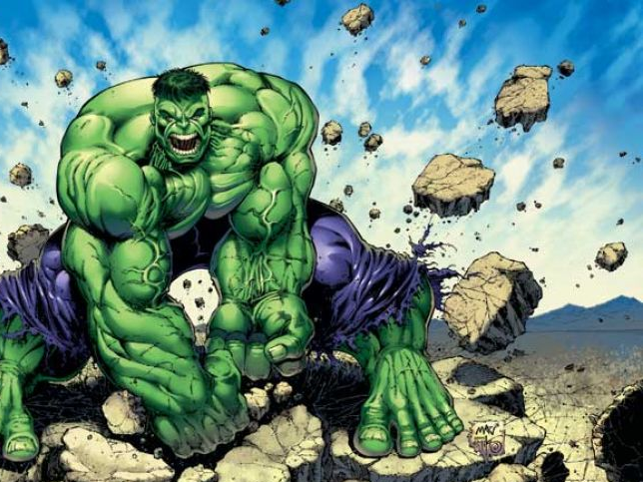
History Requirements
Chronological Awareness
Different Perspectives
Cause and Effect
Critical Thinking
Continuity and Change
Creative Thinking

Slide 6
English Requirements
Express meaning, feelings and viewpoints
Interpreting visual stimuli
Critically analyse text
Writing in a different medium
Punctuation and grammar
Develop ability to use language
Convey information creatively

Slide 7
Contact...
www.facebook.com/TeachingDividedHistories
@TDHnervecentre
Project Manager: Emma McDermott - e.mcdermott@nervecentre.org
Creative Media Facilitator: Matthew McAleer –
m.mcaleer@nervecentre.org

Slide 8
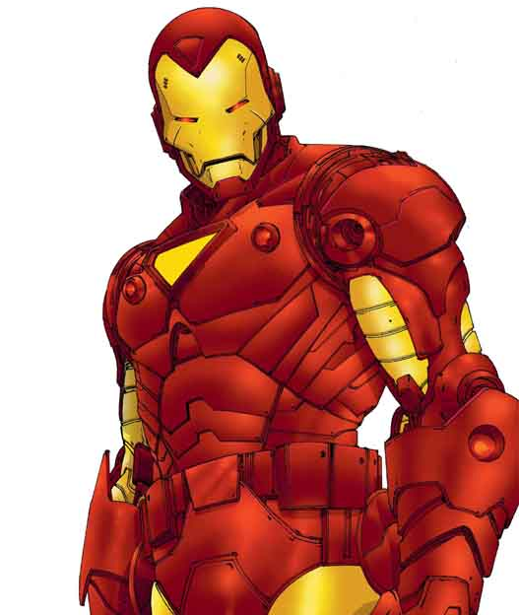
Task...
Create a comic (of at least 2 pages) telling the story of the Northern Ireland Civil Rights Movement

Slide 9
Import images
Title
Captions
Speech Bubbles
Panel effects
Picture effects
Title effects
Caption effects
Speech Bubble effects
Font effects
Background Colour

