Slide 1
Five Nations 2012
Digital citizenship in and out of the Classroom

Slide 2
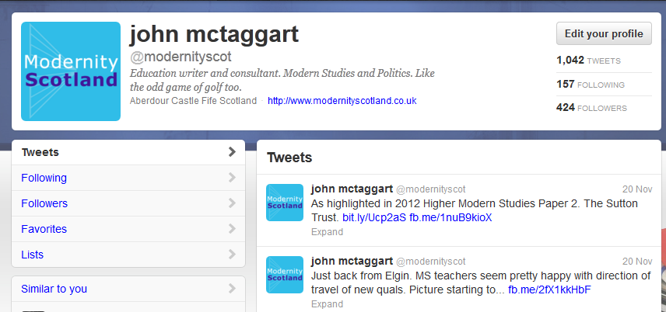

Slide 4
7 ways to use Facebook
Help develop and follow institutional policy about Facebook.
2. Encourage learners to follow Facebook’s guidelines.
3. Stay up to date about safety and privacy settings on Facebook.
4. Promote good citizenship in the digital world.
5. Use Facebook’s pages and groups features to communicate with learners and parents.
6. Embrace the digital, social, mobile, and “always-on” learning styles of 21st Century students.
7. Use Facebook as a professional development resource.

Slide 5
GCTS Guidelines on Social Media
http://www.gtcs.org.uk/web/FILES/teacher-regulation/professional-guidance-ecomms-social-media.pdf

Slide 6
1 Have an institutional policy on social media usage: GCTS
“Sound judgement and due care should be exercised as conduct which may not directly relate to pupils may be relevant to a teacher’s fitness to teach”.

Slide 7
GCTS
The behaviours listed below have warranted disciplinary measures:
● inappropriate electronic communication with pupils, colleagues and
parents/carers, including SMS and instant messaging;
● posting/sending sexually explicit pictures/images to colleagues or pupils;
● grooming - whereby a teacher uses electronic messages with a view to establishing an inappropriate relationship with a pupil;
● possessing, making, viewing or distributing indecent images of children;
● using inappropriate YouTube content in the educational setting.

Slide 8
Principles
Before posting materials online stop and ask yourself:
1. Might it reflect poorly on you, your school, employer or the teaching profession?
2. Is your intention to post this material driven by personal reasons or professional reasons?
3. Are you confident that the comment or other media in question, if accessed by others, (colleagues, parents etc) would be considered reasonable and appropriate?

Slide 9
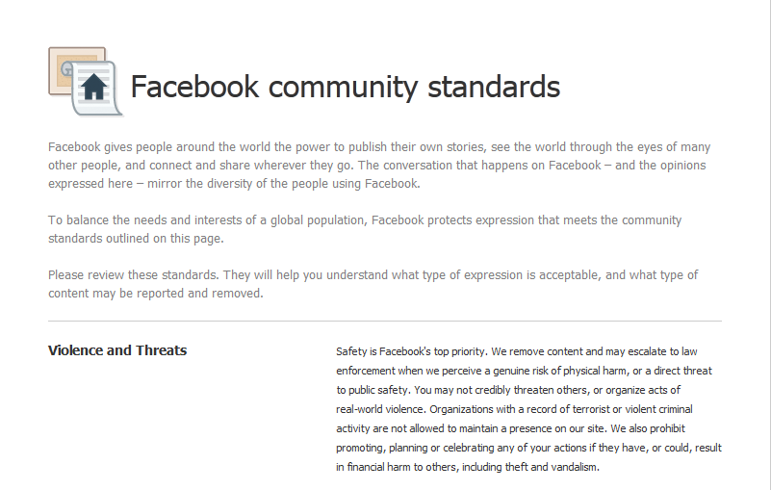
2 Facebook Guidelines

Slide 10
3 Privacy settings
You have to be 13 to use Facebook
Facebook has much stronger Privacy settings for those aged under 18 than for adults
Encourage learners to set and monitor their privacy settings

Slide 11
4 Good Citizens in the Digital World
Conducting yourself in a civil manner in the online world just like you would be expected to behave in offline world. Universal rules of social conduct apply in both environments.
Behaving responsibly and compassionately with your online actions.
Watching out for others in your online community much like you would in a ‘real world’ neighbourhood. By doing so, you are promoting a healthy and safe online community.

Slide 12
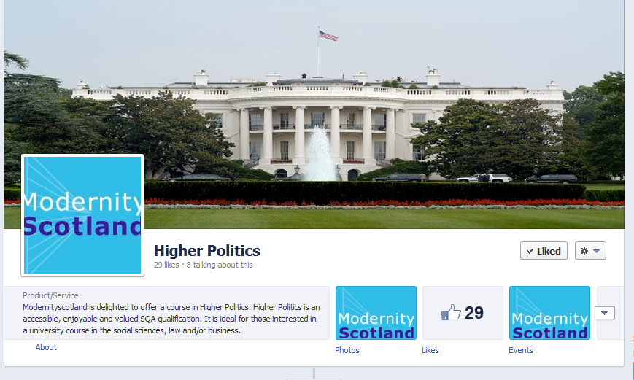
5 Create Pages
https://www.facebook.com/politicshigher

Slide 13
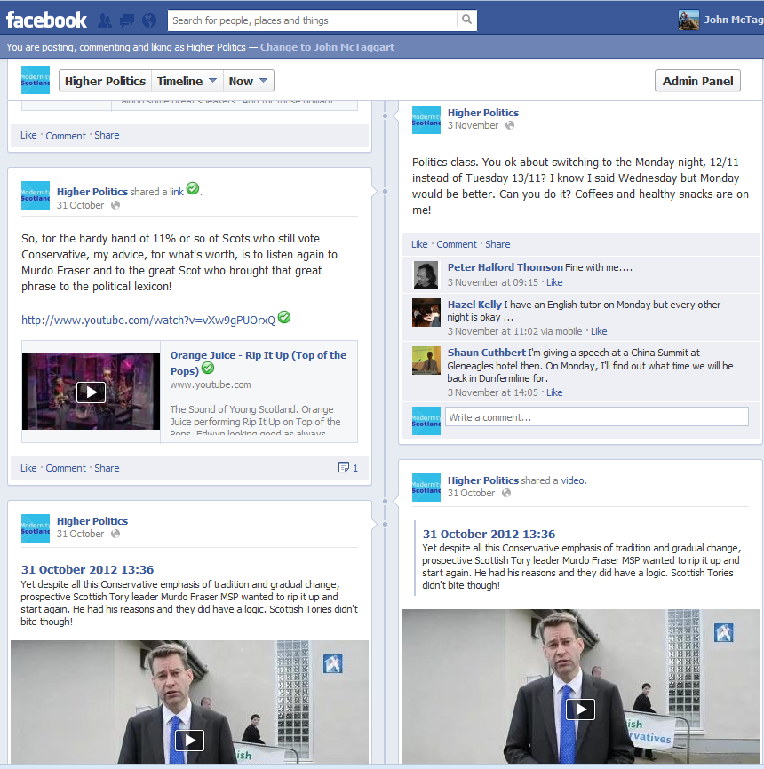
Pages can open new opportunities for teaching and learning. Most young people are already accessing Facebook using their mobile phones when not at school. Now the learning opportunity can reach them where they live
online.

Slide 14
6 Embrace the Digital, Social, Mobile and “Always- On” Learning Styles of 21st Century Students
Interactive: Learners who create their own content and interact via social media can express their identity and creativity.
• Learner-Centred: Shifts the learning responsibility to the learner, requiring learners to take a more active role in their own learning process
• Authentic: The use of social media and technology should be tied to a specific learning goal or activity.
• Collaborative: Learning is a social activity, and many learners learn best through working with a group of peers. This collaboration and peer feedback can take place in either a virtual or in-person environment.
• On-Demand: Course content should be made available “on-demand” so the learner can view course materials when, where, and how they want to view the content, whether on a desktop computer, mobile phone or other handheld device.

Slide 15
7 Use Facebook as a Professional Development Resource
Five Nations Network Facebook page?

