Slide 1

Better Values? Better Attitudes?: a case study of the impact of an innovative approach to teaching and learning about citizenship in a secondary (high) school and its associated primaries in the West of Scotland.
Henry Maitles
University of the West of Scotland

Slide 2
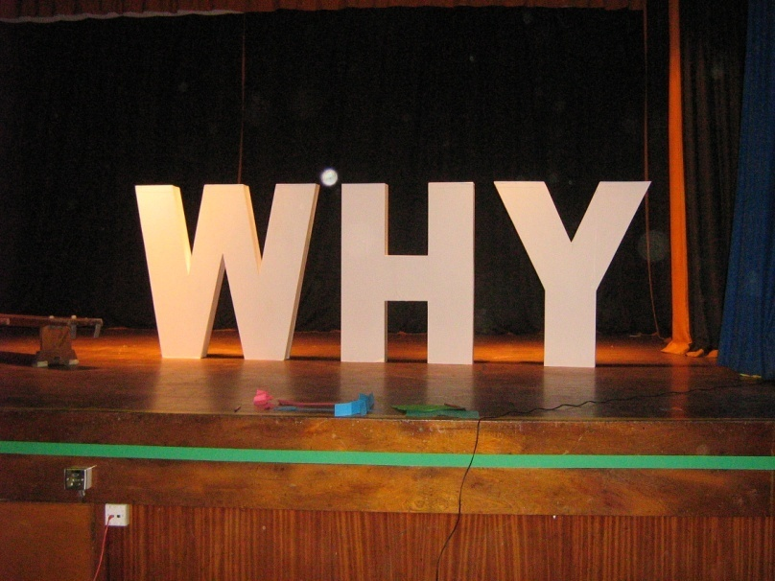
THE PURPOSE OF THE PROGRAMME
“If we do not learn from our mistakes, how can we prevent them from happening again?”
The aim of the programme was to educate young people about human rights, respect, racism and how genocides can occur and what can be done to prevent this from happening again.

Slide 3
Better Values? Better Attitudes?
Research Questions
    Examine the programme of citizenship
    learning put in place;
    Is there an impact – in this instance short term --
    in promoting positive values and attitudes,
    outwith the traditional structures of learning?
    A gender factor?

Slide 4
Better Values? Better Attitudes?: The Programme
All S1 pupils + P7 associated primaries;
All off timetable for 12 days;
Active learning at its core;
Days 1-2: ‘what does it mean to be human?’;
Days 3-6: ‘Human Rights workshops’;
Day 7-8: UNICEF ‘rights respecting school’ activities;
Days 9-10: trips and workshops outside school relating to Scotland, diversity and racism;
Days 11-12: Holocaust and Genocide.

Slide 5
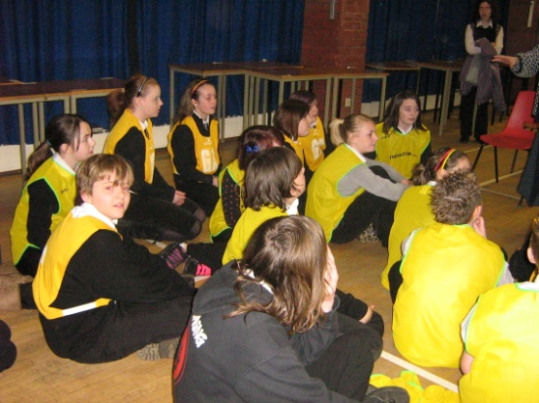
The Two Genocide days
The students progressed through a series of workshops during the course of the days.
The workshops focused on the Holocaust, the stages of genocide, the Rwandan genocide, Anne Frank, and the S5/S6 trip to Auschwitz.

Slide 6
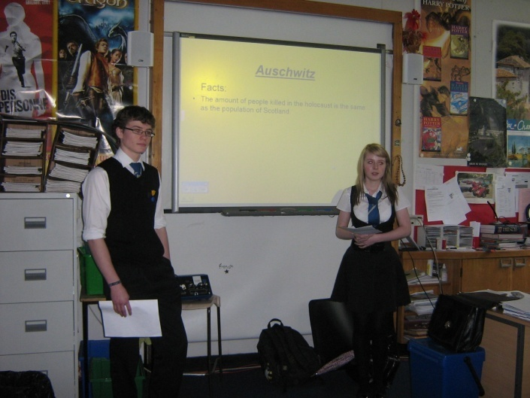
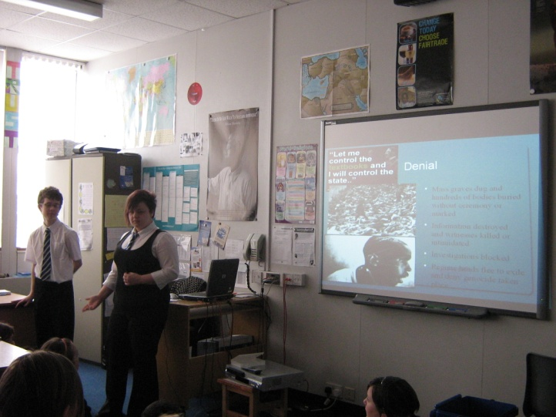
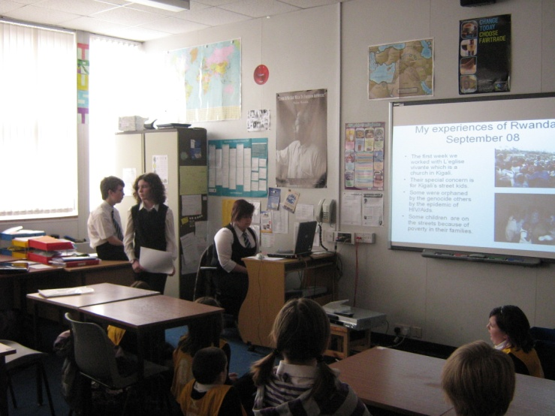
S6 pupils speaking about their trip to Auschwitz
S1 pupils speaking about the 8 stages of genocide
Primary pupil speaking of her experiences in Rwanda post-genocide

Slide 7
Better Values? Better Attitudes?:
Methodology and Sample
    In conjunction with the school, a values and attitudes questionnaire was drawn up, using experience of Angvik and von Borries (1997), Hahn (1998), Kerr et al (2004), Maitles (2002), Maitles and Cowan (2006), Torney Purta et al (2001), Whiteley (2005). The pupils (aged 12-13) were asked to complete the questionnaire immediately before the citizenship initiative started and immediately after it ended;
    Questionnaire 1: 222 pupils (110M and 112F) and Questionnaire 2: 214pupils (106M and 108F)
    Follow up interviews and surveys

Slide 8
Better Values? Better Attitudes?:
Findings 1: Equality

Slide 9
Better Values? Better Attitudes?:
Findings 2: Multi-Ethnicity

Slide 10
Better Values? Better Attitudes?:
Findings 4: Challenging Racism

Slide 11
Better Values? Better Attitudes?:
Gender issues 1

Slide 12
Better Values? Better Attitudes?:
Gender issues 2

Slide 13
Better Values? Better Attitudes?:
Gender issues 3

Slide 14
Better Values? Better Attitudes?:
Gender issues 4

Slide 15
Better Values? Better Attitudes?
Conclusions
Overall, there is evidence of a general improvement in values and attitudes after the pupils undertook the initiative;
The two areas that may need some examination in terms of overall strategy are attitudes towards English people and gay people. Negative attitudes towards both are problematic and may not be challenged in away that other aspects of discrimination are;
The gender issues are perhaps predictable from previous research from other places but are nonetheless stark. There is going to be no easy way to deal with this. Girls in this sample are not only outperforming boys academically but are displaying a more balanced and sophisticated social outlook in general.

