Slide 1
Developing 'Political Generosity' through Classroom Deliberation
Lesley Emerson School of Social Sciences, Education and Social Work Queen’s University Belfast
l.emerson@qub.ac.uk

Slide 2
Overview
Discussion, debate and deliberation – setting the scene
Discussing discussion
Debating debates
Political generosity - as an idea; pedagogical principles
Structured Academic Controversy – activity
Deliberating deliberation
Socratic questioning – activity
Questioning questions

Slide 3
D D D
discuss debate deliberate

Slide 4
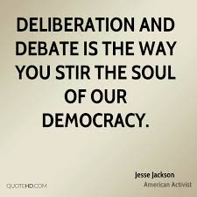
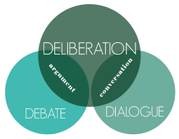
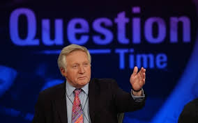
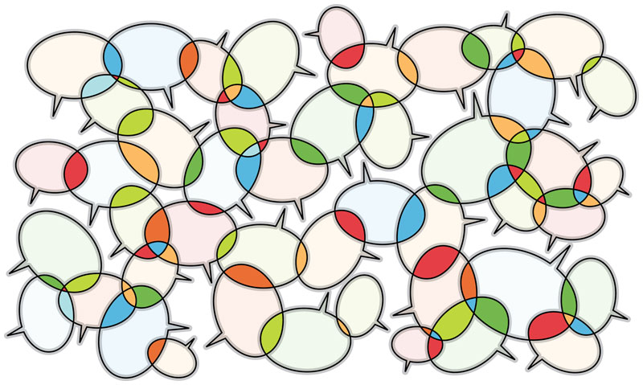
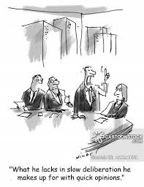
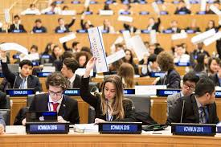
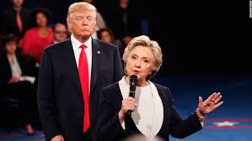
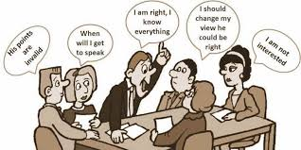
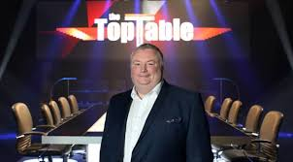

Slide 5
Discussing discussion: reflecting on practice
Prep required | Some prep required | Ongoing
Gallery or chat stations Silent conversations Walking debate Hot seat or ‘philosophical chairs’ Socratic seminars Jigsaw group work Etc. | Post it clustering Carousel discussion Fishbowl Fishbowl with ‘coaching’ or ‘tag team’ Snowball Etc. | Think-pair-share 5 whys Speed re-teach Discussion fora, tweets ‘No easy answers’ board Graffiti wall Etc.

Slide 6
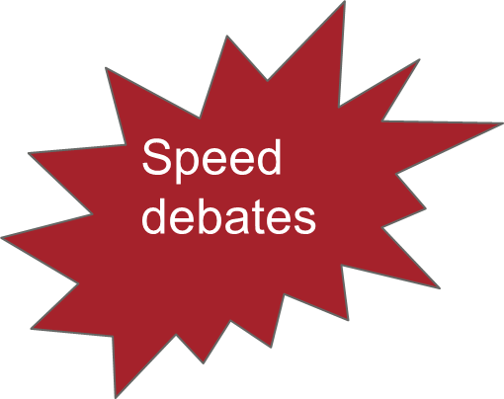
Debating debates: reflecting on practice
Formal debates
What are the advantages and disadvantages of debates?
Structured academic controversy

Slide 8
Overview
Discussion, debate and deliberation – setting the scene
Discussing discussion
Debating debates
Political generosity - as an idea; pedagogical principles
Structured Academic Controversy – activity
Deliberating deliberation
Socratic questioning – activity
Questioning questions

Slide 9
‘Political generosity’
Capacity for ‘political generosity’ is the ability to legitimise the cultural and political identity/perspectives of those with opposing views, primarily on the basis of their right to hold them.
Individuals having confidence in their own cultural and political identity and in their right to hold and express it.
Both requires and engenders trust:
psychological repertoire that ‘accepts, recognizes, respects, legitimizes, humanizes and personalizes the rival or discriminated group’ (Bar-Tal 2004, 263).
politically pragmatic in nature.

Slide 10
Education for ‘political generosity’: emerging pedagogical principles
Acknowledge the past:
Engaging with antecedents of socio-political issues helps young make sense of their current socio-political context, by exploring the nature of the problem and the dynamics of the solutions in the past
Engage with polyvocal narratives:
Provide multiple perspectives; use nuanced resources that convey cognitively and emotionally engaging personal narratives; draw on narratives that attest to the political as well as the personal; provide a conceptual framework in which young people can deliberate and self position
Disrupt ‘given’ perspectives:
Challenge myths; disrupt homogenised official narratives; disrupt potentially biased perspectives generated at home, in communities and through the media; narrow the ‘space for permissible lies’

Slide 11
Education for ‘political generosity’: emerging pedagogical principles
Acknowledge the past:
Engaging with antecedents of socio-political issues helps young make sense of their current socio-political context, by exploring the nature of the problem and the dynamics of the solutions in the past
Engage with polyvocal narratives:
Provide multiple perspectives; use nuanced resources that are cognitively and emotionally engaging; draw on narratives that attest to the political as well as the personal; provide a conceptual framework in which young people can deliberate and self position
Disrupt ‘given’ perspectives:
Challenge myths; disrupt homogenised official narratives; disrupt potentially biased perspectives generated at home, in communities and through the media; narrow the ‘space for permissible lies’

Slide 12
Overview
Discussion, debate and deliberation – setting the scene
Discussing discussion
Debating debates
Political generosity - as an idea; pedagogical principles
Structured Academic Controversy – activity
Deliberating deliberation
Socratic questioning – activity
Questioning questions

Slide 13
Structured Academic Controversy: definition
A discussion that moves students beyond either/or debates to a more nuanced synthesis.

Slide 14
Structured Academic Controversy: preparation
Choose a question that lends itself to contrasting viewpoints.
Find and select two or three documents (primary or secondary sources) that embody each side.
Consider timing, make copies of handouts, and plan grouping strategies. Plan on using about an hour.

Slide 15
Structured Academic Controversy: procedure
Organize students into four-person teams comprised of two dyads. Each dyad reviews materials that represent a range of different positions.
Dyads come together as a four-person team and present their views to one other, one dyad acting as the presenters, the others as the listeners.
Rather than refuting the other position, the listening dyad repeats back to the presenters what they understood.
Listeners do not become presenters until the original presenters are fully satisfied that they have been heard and understood.
Second dyad presents; first listens
Dyads abandon their original assignments and work toward reaching consensus. If consensus proves unattainable, the team clarifies where their differences lie.

Slide 16
Structured Academic Controversy: issues
Students' debate framework runs deep –they will try to find holes in their opponents’ positions and aim to refute them.
Reinforce the idea of "active listening" to your students.
Establishing the rule: make notes when confused, do not interrupt the presenters.
Display the procedures
The absence of a certain answer may confuse them.
Reassure students that uncertainty and complexity are expected.
Encourage them to make notes that specify their confusion, new ideas or questions.

Slide 17
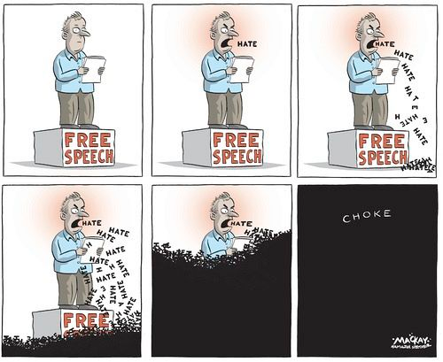
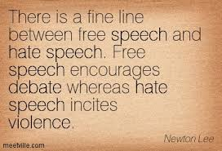
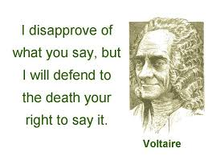
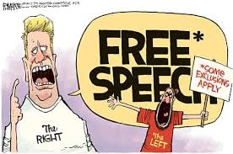
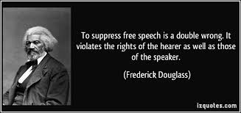

Slide 18
Deliberation:
Should government allow ‘hate speech’?

Slide 19
http://deliberating.org/
http://www.osdemethodology.org.uk/secondaryschools.html

Slide 20
Overview
Discussion, debate and deliberation – setting the scene
Discussing discussion
Debating debates
Political generosity - as an idea; pedagogical principles
Structured Academic Controversy – activity
Deliberating deliberation
Socratic questioning – activity
Questioning questions

Slide 21
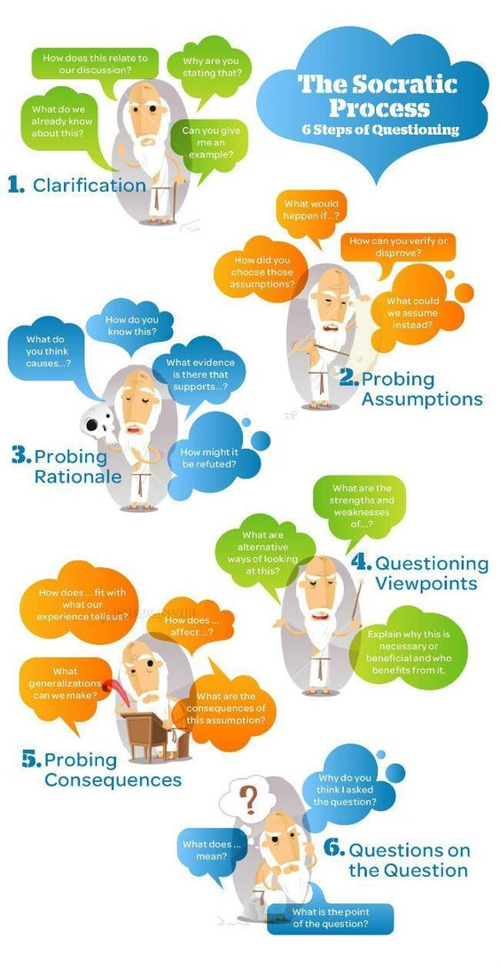
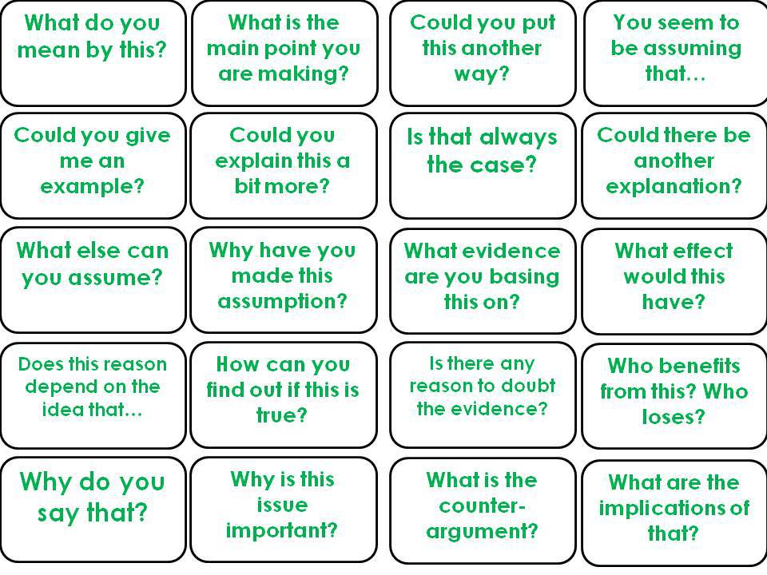
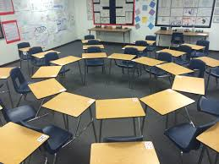

Slide 23
Overview
Discussion, debate and deliberation – setting the scene
Discussing discussion
Debating debates
Political generosity - as an idea; pedagogical principles
Structured Academic Controversy – activity
Deliberating deliberation
Socratic questioning – activity
Questioning questions

Slide 24
Overview
Discussion, debate and deliberation – setting the scene
Discussing discussion
Debating debates
Political generosity - as an idea; pedagogical principles
Structured Academic Controversy – activity
Deliberating deliberation
Socratic questioning – activity
Questioning questions
Re-write ‘How to spot a weak argument’
as
‘How to spot politically generosity’

