Slide 1
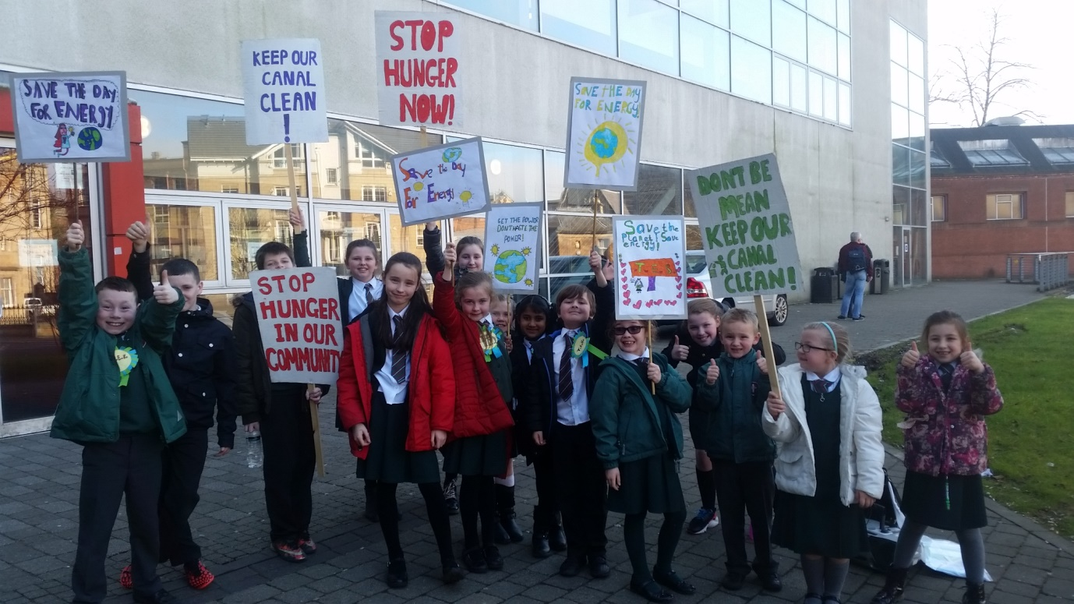
Active Citizenship and Participation – St.Eunan’s Primary School

Slide 2
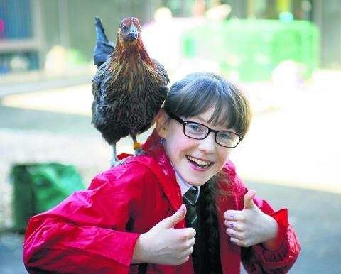
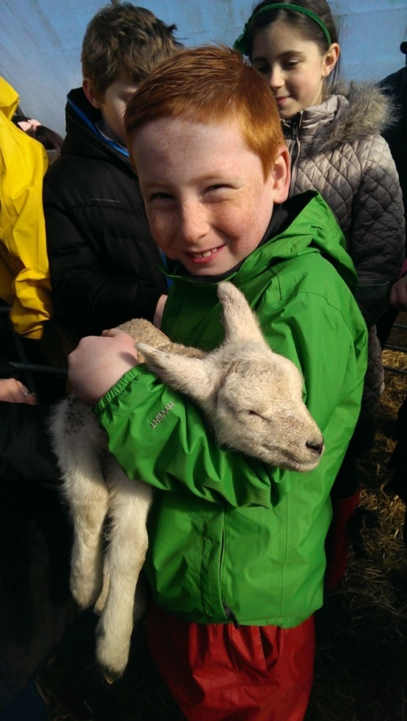
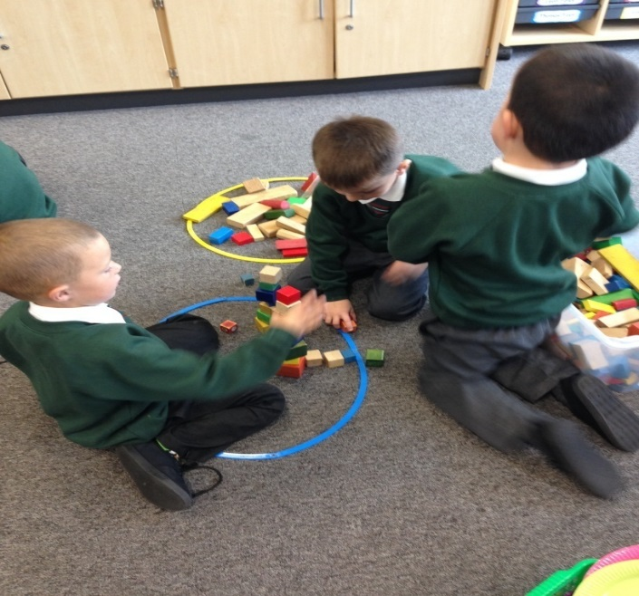
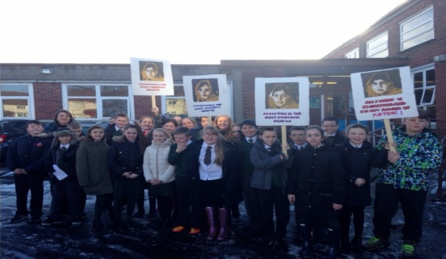
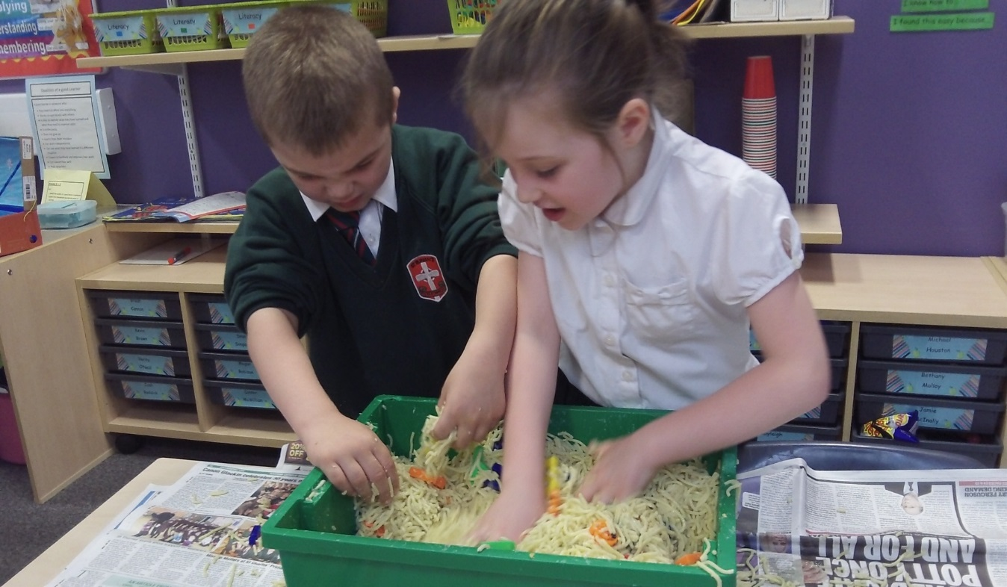
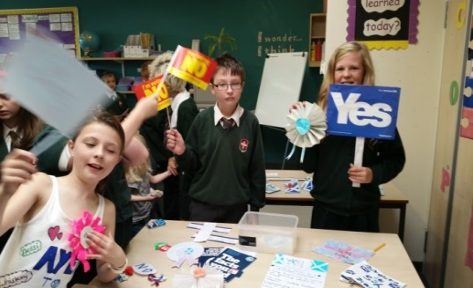

Slide 3
Vision and Values
What are the core beliefs that define the school’s culture?
Shared vision - What will the school look like when its core beliefs inform practice?
Shared sense of purpose concerning both the content and process of change.
Notes:
It takes time to develop a culture of self-evaluation for improvement. It’s not something that can happen quickly though gradual changes to practice and policy can have a significant impact on the progress of the journey.

Slide 4
Vision and Values
GIRFEC Skills based approach Learning Logs
Nurture groups
Lunch time sanctuary club
Seasons for growth
Cedar
Rights respecting agenda
Restorative
Anti bullying monitors
Lunch time guardians
Pupil council
Pupil Learning and Teaching group
JRSO
Buddies
FAST
Anti- sectarianism
Creativity/Hen Project
Partners

Slide 5
Self-evaluation
Rationale – to deliver a curriculum, based on principles of design, that excites and motivates children to want to engage in learning
Curriculum overviews – ensure required coverage, appropriate depth
Breakdown of levels across stages
Pupil dialogue covers quality of content and delivery of lessons – all responses are shared with class teachers and outcomes discussed with children
Ongoing review – what now? How does this impact on progress/attainment
Dialogue about planning and use of assessment information to inform this
Written feedback with action points.
Class visits – curriculum in action
Dialogue with children and opportunities for them to contribute to planning
Feedback from teachers, children, parents and partners
Focus on impact – Why are we doing things this way? Outcome?
Mantra – that’s good – how can we make it better?

Slide 6
Curriculum
Rationale
Principles of design
Themes across Learning
Skills focus including HOTS
IDL

Slide 7
Rationale for Interdisciplinary Learning approach
Rights Respecting School - enrich learning of Rights, embed across the curriculum
Move from charity work/ citizenship to active citizenship
Representing my class, school and/or wider community encourages my self-worth and confidence and allows me to contribute to and participate in society.
HWB 2-12a
Through contributing my views, time and talents, I play a part in bringing about positive change in my school and wider community.
HWB 2-13a

Slide 8
Three Key Contexts
Referendum IDL (Primary 7)
Right to an Education whole school IDL/Campaign
SDGs whole school IDL and ‘I Can Make a Difference’ initiative

Slide 9
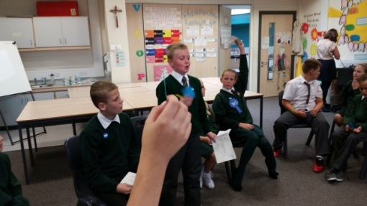
Referendum Effect
Primary 7 - IDL Referendum
Children engaged by real social, economic, political issues
Identification of injustice - possible solutions
Participation in informed debate and secret ballot on Referendum day
Experience of YES and Better Together campaigns
Express an informed point of view
Pupil Participation
Engaging with Democracy
Political Literacy
Debate
Persuade
Inform others
Formulate opinion
Research
Reason

Slide 10
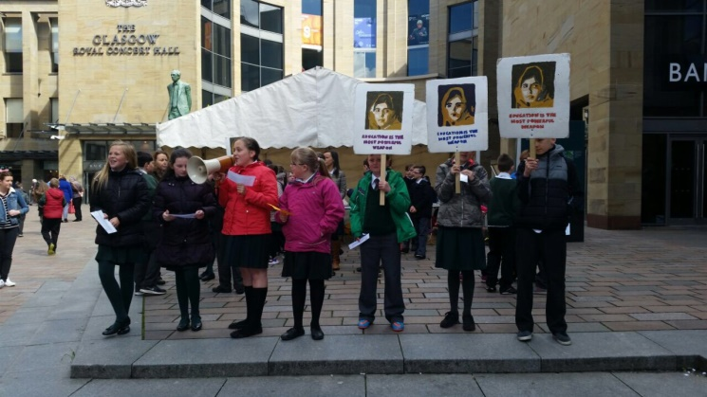
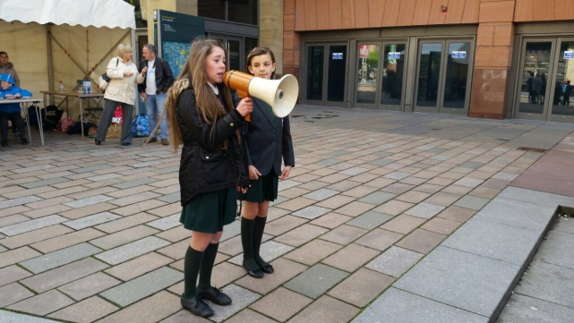
Article 28 (Right to an Education) IDL and Education Every Child Everywhere Campaign
Whole school IDL/each stage - different contexts within wider context
Experience of Referendum campaign - ownership of own campaign
Learning beyond the classroom
Created own petition
Notion of power/use of voice for positive change
Contribution to and participation in society
Pupil Empowerment
Pupil Participation
Positive Contribution
Active Citizenship
Political Literacy
Social Justice

Slide 11
Experience of Primary 7 Campaign
Successful in achieving raised levels of:
Attainment
Engagement
Motivation
Parental Involvement(Interest/Feedback)
Due to…
Meaningful tasks/learning intentions – every lesson for a purpose
Ownership – ‘making a difference to a real world issue’
Current/topical – in news/papers/online
Use of partners
Learning beyond the classroom

Slide 12
I Can Make a Difference IDL Active Citizenship Initiative
Whole school IDL exploring the Sustainable Development Goals
Participation in local/global community as core element
Each stage explored a different goal, taking part in some form of campaigning or social enterprise.
Scotland - first country to sign up to the Global Goals
"The UN’s Sustainable Development Goals offer a vision of the world that I believe people in Scotland share. We need to grasp the opportunity that following this path offers to create a fairer Scotland and a better world both now and for generations to come.”
(Nicola Sturgeon, First Minister)

Slide 13
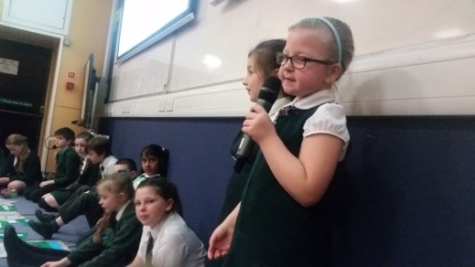
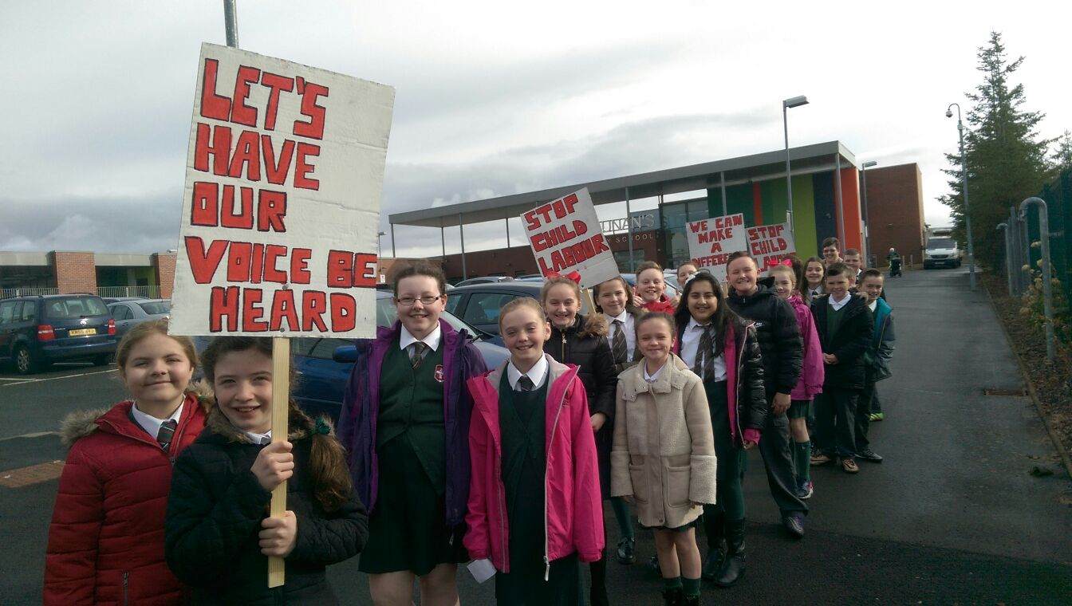
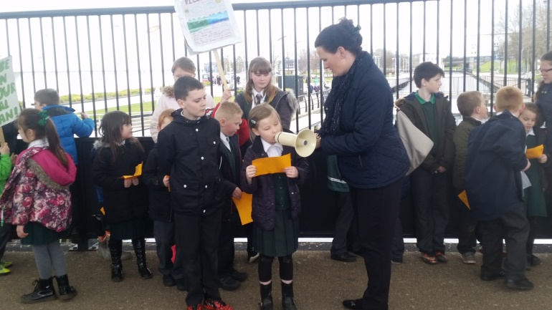
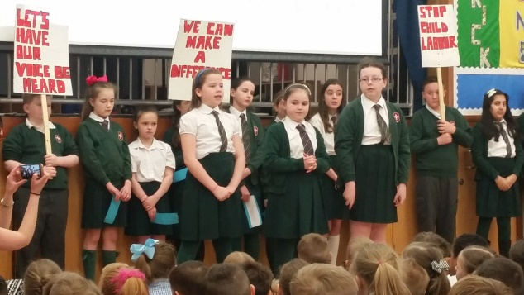
Primary 2
Primary 6
Explored the issue of Child Labour today and in the UK in Victorian Times.
Campaigned against Child Labour
Campaign to clean up the canal embankment
Primary 7 worked with P.2 to create persuasive placards for their peaceful protest

Slide 14
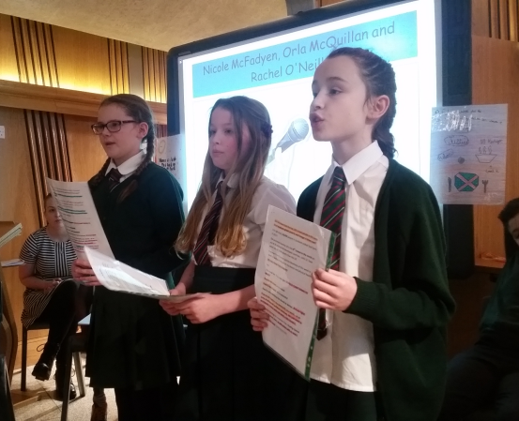
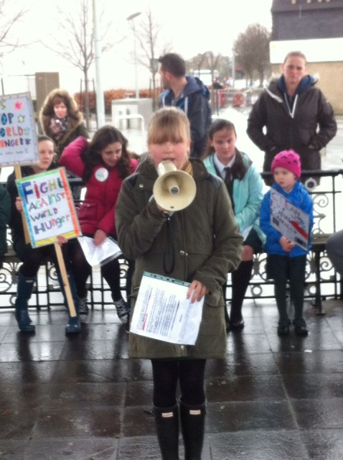
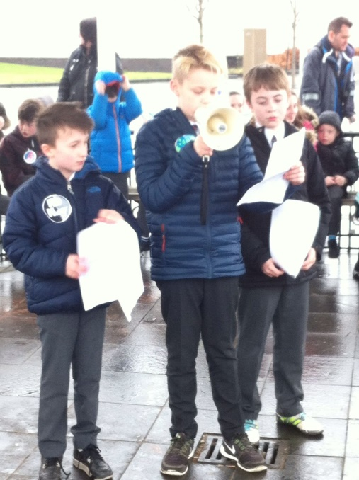
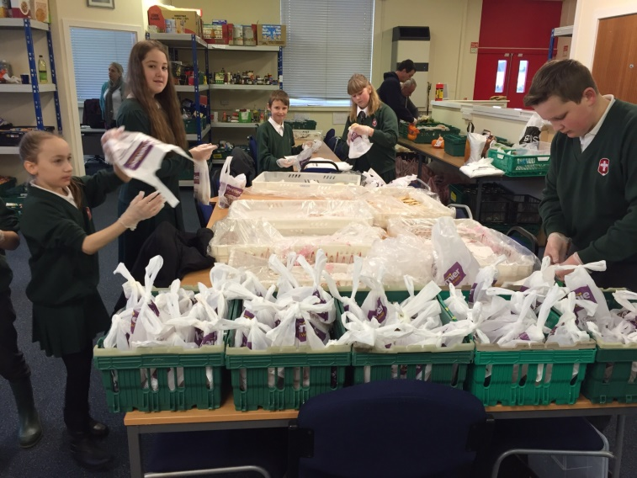
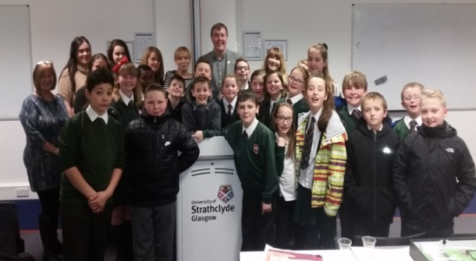
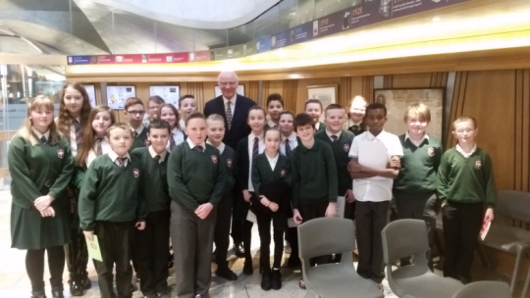
Primary 7
Explored causes and consequences of Global/Local hunger
Contribution to local community through partnership with West Dunbartonshire Community Food Share
Wrote and delivered speeches to various audiences, inc. MSPs at Parliament
Gathered signatures for a petition

Slide 15
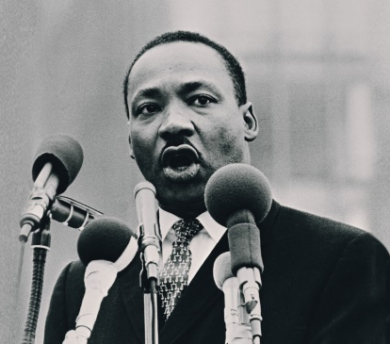
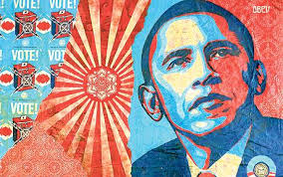
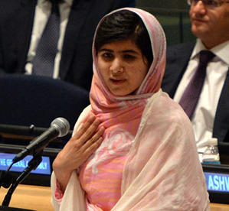
Use of Voice – The Power of Speech
Famous speeches used as a teaching resource
Identification of figurative language, rhetorical devices to engage and inspire the listener/audience
Pupils create their own speeches applying the tools/language used in famous speeches to their particular learning context.
Pupils taught the use of gesture, intonation, pace, emotion, by listening and watching famous speeches.

Slide 16
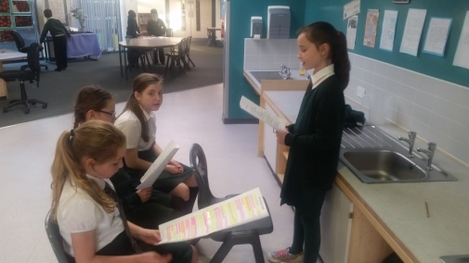
Use of Voice
Takes time and lots of practise
Children help each other; more skilled, natural speakers model and advise peers
Senior pupils support younger pupils to create very simple short speeches
Children highly motivated because they know they will have the opportunity to deliver their speech to an audience
Almost all pupils participate fully and read out their speech at some point in the project.
‘

Slide 17
‘It has made me realise what’s going on around the world, it makes me sad and angry, but happy and proud that I can try to do something about it. I can stand up and make a point and make everyone realise that not everyone is having the life that we’re having. It made me more confident, it made me realise that I can do something.’
Connor
‘It makes you question things; like - now I know that Government policies are one of the causes of hunger and poverty… because of cutting people’s benefits.’
Lauren
‘In school I’ve been working harder, your education can be used to help others, to stand up for people’s rights.’
Orla
‘I watch the news more now, I got more interested with the Independence vote and with all that we’ve learned in Primary 7. I’m really confident now, campaigning, going out of school presenting and volunteering.’
Orla
‘It gives you a deeper understanding of world issues, instead of your parents talking and you sitting there, you can give your opinion and join in the conversation.’
Kerry

Slide 18
Impact
Motivated and engaged students
Raised attainment in Literacy
More politically literate students
Increased confidence and self-esteem
Increased parental involvement

Slide 19
What now?
Differentiation
Planning Boundaries
??
??

