Slide 1
Parliament’s Education Service – Digital resources

Slide 2
Contents
Overview of Parliament’s Education Service
Overview of www.parliament.uk/education
Social media
How Parliament works: some common misconceptions
Questions

Slide 3
Section One
1. Overview of Parliament’s Education Service

Slide 4
Parliament’s Education Service
“Working with schools to support young people’s understanding of Parliament and democracy”

Slide 5
Goals
Parliament’s Education Service aims to:
Inform young people about the role, work and history of Parliament
Engage young people to understand the relevance of Parliament and democracy today
Empower young people to get involved by equipping them with the knowledge and skills to take part

Slide 6
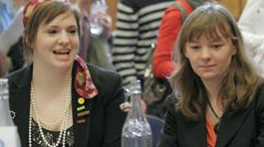
Key activities
School visits to Parliament
Outreach to schools
Teacher training
Active learning projects and competitions
Online resources

Slide 7
Key achievements last year
Over 40,000 school students visiting Parliament
2 million page views on www.parliament.uk/education
1,110 teachers trained

Slide 8
Working with other Parliaments
Outreach to schools across the UK
School visits run with the Scottish Parliament, Welsh Assembly and Northern Ireland Assembly
‘Your Voice’ workshops mention local campaigns

Slide 9
Section Two
2. Overview of www.parliament.uk/education

Slide 10
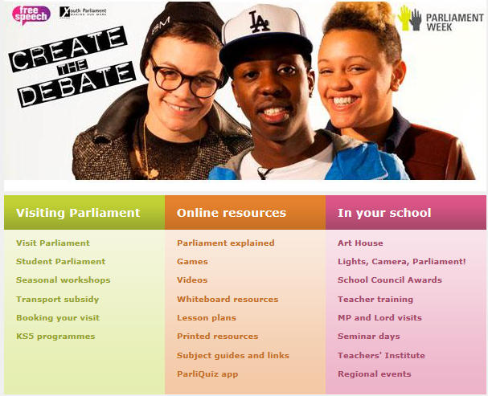
Website overview

Slide 11
Formal learning: Whiteboard resources
An introduction to Parliament
Elections and voting
Making laws
Teachers notes and worksheets / lesson plans accompany each one

Slide 12
Interactive whiteboard resources
Example whiteboard activity: Compare the vote

Slide 13
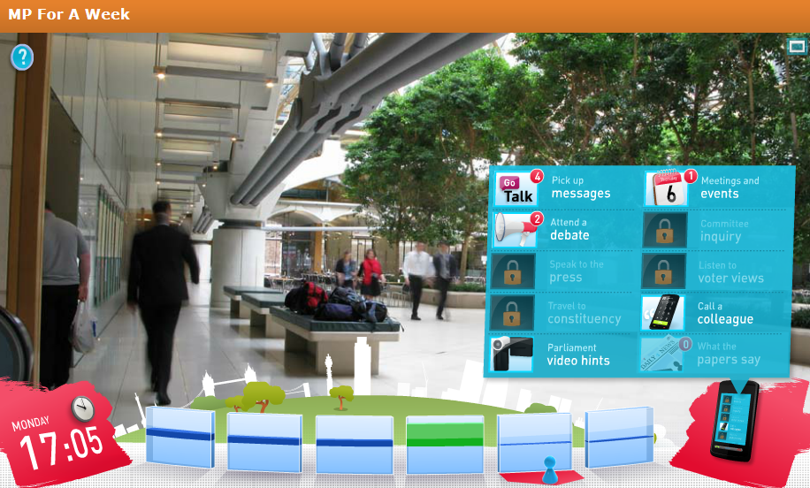
MP For A Week

Slide 14
Learning outcomes
Summary of the work of MPs, for example:
attending debates and making speeches
taking part in select committee inquiries
constituency duties eg. attending local events
Decision-making:
Prioritisation of tasks
Making difficult choices eg. when loyalty to constituents and party conflict

Slide 15
Feedback

Slide 16
Outcomes
2010 / 11 it was played approx. 82,000 times
It has won several awards including gold BETT and e-Learning awards
Positive comments from teachers
One of the most popular items on our site
Challenges:
Length of playing time
Awareness of features for teachers
Go to MP For A Week

Slide 17
Section Three
3. Social Media

Slide 18
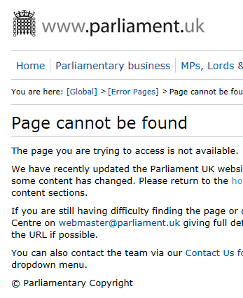
Social Media for Schools
Opportunities:
Near-ubiquitous use of social media
Barriers:
Social media sites can be blocked in schools
Security of young people’s data

Slide 19
Lights, Camera, Parliament!

Slide 20
Engaging students directly
Students don’t frequently visit the UK Parliament website
Students do frequently visit social networking sites like Facebook
To reach students directly, our content needs to be available in the locations they regularly visit

Slide 21
MyUK

Slide 24
MyUK
A fun look at how laws are made
Students can give regular updates to friends on Facebook or Twitter
Shorter than MP For A Week, to fit patterns of social network usage
Hosted on a separate website
Attempts to appeal to students directly

Slide 25
Twitter

Slide 26
Twitter
Good platform for reaching teachers
Currently used for announcing new resources, availability in our teaching training programme etc.
UK Parliament Twitter seeks to stimulate dialogue eg. #AskGove
New Twitter strategy in progress

Slide 27
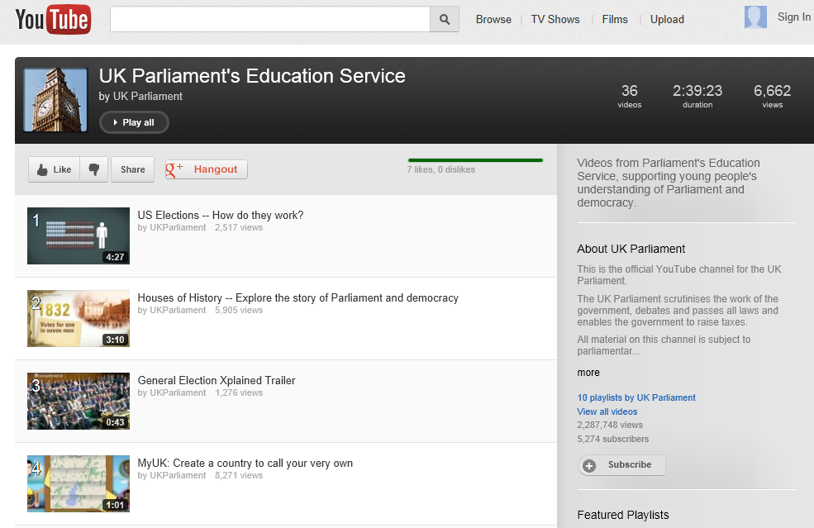
YouTube

Slide 28
Section Four
4. How Parliament works – some common misconceptions

Slide 29
Youth political engagement

Slide 30
Three parts of Parliament

Slide 31
Parliament and government

Slide 32
Scrutinising government

Slide 33
Parliament’s legislative role

Slide 34
Parliament has nothing to do with me
An MP represents ... who?
The functions of Select Committees

Slide 35
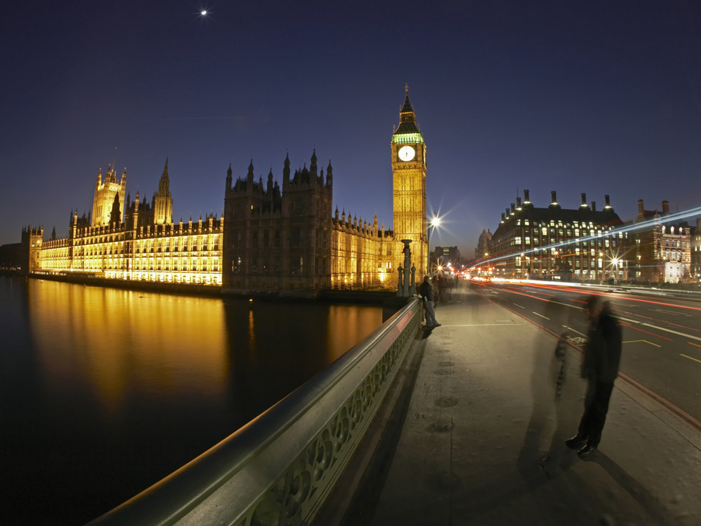
Thank You

